Slide 1
Monday Bell Ringer Lab Safety
What should you do if a glass breakage occurs?
A. Touch it to see if it is safe.
B. Run out of the classroom.
C. Immediately contact your teacher.
D. Leave it where it is without telling anyone.

Slide 2
Tuesday Bell Ringer Levels of Organization
What is the largest geographic area that contains all the ecosystems on Earth called?
A. Biome
B. Biosphere
C. Ecosystem
D. Environment

Slide 3
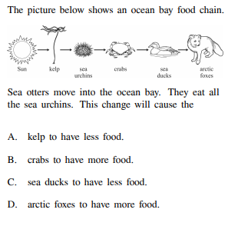
Wednesday Bell Ringer Food web

Slide 4
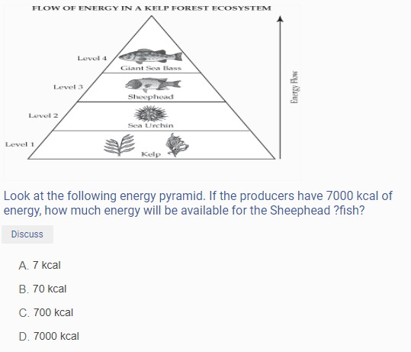
Thursday Bell Ringer Energy Pyramid

Slide 5
Friday Bell Ringer Symbiotic Relationship
A lichen is a combination of fungus and algae that lives on the sides of trees, rocks, and other materials. The fungus provides the algae with water and minerals and the algae uses the water and minerals to make food for both organisms. What type of relationship does the lichen represent?
A. Parasitism
B. Commensalism
C. Mutualism

