Slide 1
Mechanisms of Evolution
CSCOPE
Unit:09
Lesson: 01

Slide 2
Evolution
The Theory of Evolution describes the slow change in organisms that occurs over many generations.

Slide 3
Scientific Definitions Analysis:
Be prepared to share your response to the following:
Biological evolution happens at the __________ level, not the individual organism level.
All three definitions mention genetic changes or changes in allele frequency within a population from one generation to the next.
Based on what you have learned about evolution and genetics in the past, list 2 or 3 events or circumstances that could cause these changes.

Slide 4
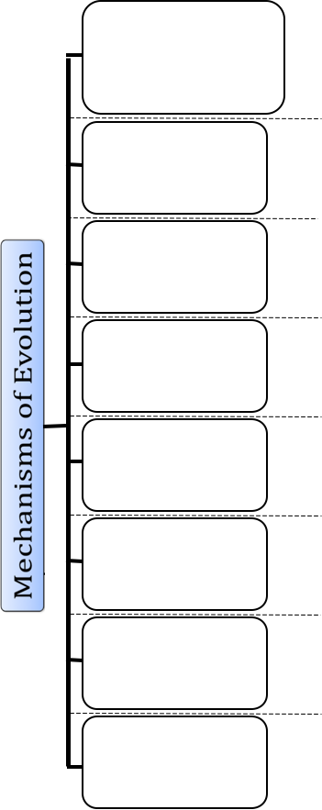
Folding the Graphic Organizer
Steps:
1. Remove the excess paper from the top and bottom by cutting along the dotted lines shown below in red.

Slide 5
Folding the Graphic Organizer
2. Fold along the center line shown in red below.

Slide 6
Folding the Graphic Organizer
3. Cut along the dotted lines between each box.
Stop cutting where the dotted lines end.

Slide 7
Folding the Graphic Organizer
4. Fold along the red dotted lines shown below so
that each box folds open.

Slide 8
Folding the Graphic Organizer
5. Glue the section highlighted in yellow below to
the back page so that only the tabs will fold
open.

Slide 10
Natural Selection
Mutations
Recombination
Gene Flow
Genetic Drift
Artificial Selection
Non-Random Mating
Reproductive Isolation

Slide 11
Natural Selection
The process by which organisms change over time, as those best suited to their environment survive to pass their traits to the next generation.

Slide 12
Mutations
An alteration in the genetic material that is more of less permanent and that can be transmitted.
Accidental
May be beneficial

Slide 13
Recombination
Event occurring by the crossing over of chromosomes during Meiosis.
Genes may become linked or unlinked.

Slide 14
Gene Flow
The introduction of genetic material by interbreeding from one population of a species to another, changing the composition of the gene pool of the receiving population.

Slide 15
Genetic Drift
A change in the gene pool of a small population that takes place strictly by chance.
Traits may be lost or become more common.
Usually occurs in small, isolated populations in which the gene pool is small enough that chance events can change its makeup in a significant way.
Large populations – a specific allele is carried by so many individuals that it is almost sure to be transmitted by some of them.

Slide 16
Artificial Selection
Heritable variations in a species are manipulated by humans through controlled breeding.
Breeder tries to isolate and choose the genotypes that are responsible for a desired characteristic.

Slide 17
Non-Random Mating
Occurs when the probability that two individuals in a population will mate is not the same for all possible pairs of individuals.
Two Forms
Inbreeding
Outbreeding

Slide 18
Reproductive Isolation
The change in the frequency or occurrence of a gene in a population as a result of chance.
Process that prevents gene flow between two populations of the same species.
Geographic Barriers
Behavioral Differences
Structural Differences
Different Mating Seasons

Slide 19
Darwin’s Theory of Natural Selection: 4 Key Principles
Overproduction
Inherited Variation
Competition
Selection

Slide 20
Overproduction
A population produces more offspring than can possibly survive.

Slide 21
Inherited Variation
Each individual in a population has its own set of traits.
Inherited variation – are differences in the traits of individuals of the same species.
Unfortunately, Darwin was unaware of the work of Gregor Mendel (heredity); otherwise he would have been able to explain the inherited variations he observed among the individuals in a population.
The beak of each species of finch is adapted to obtaining the food in its environment.

Slide 22
Competition
There is competition among the individuals within a population.
Resources are limited, populations must struggle to survive.
Food, Shelter, Water
Avoid disease and predators

Slide 23
Selection
Those individuals that win the struggle for survival will be able to reproduce.
Traits needed to survive.
Adaptation – a trait that increases an organism’s chances of survival in its environment.
Offspring will inherit these traits and pass them off to their offsrping.
After many generations, more members of the species will have the favorable traits.

Slide 24
Exploring Darwin & His Ideas
Think about the following questions:
What explains the explosion of living creatures on Earth—1.4 million different species discovered so far?
To what prediction did the finches collected on the Galapagos lead Darwin?
What did Darwin predict causes one species to turn into another?
What domesticated animal helped lead Darwin to the idea of natural selection?
What questions did Darwin’s insight about evolution raise?

Slide 25
Video of Darwin

Slide 26
Differential
Reproductive
Success
Notes:
Instruct students to draw this concept map in their science notebooks. Explain that the map is designed to help them understand the components of differential reproductive success and how it relates to natural selection.

Slide 27
A
B
C
E
F
D
Differential
Reproductive
Success
Natural Selection
Notes:
Discuss the concept map before filling in the information. This will help students organize their thinking.
Ask:
According to the concept map, which letter represent the components needed from differential reproductive success (DRS) to occur? (D,E,F)
According to the concept map, what does DRS lead to? (G)
According to what was learned in the candy activity, what do you think letter D is? (Students may say variation, but guide them in this direction if they are unable to come up with that answer.)

Slide 28
Limited
Resources
Organisms produce more offspring than can survive.
Environmental Factors
Fitness
Competition
Genetic
Variation
Differential
Reproductive
Success
Natural Selection
Notes:
Make sure students know the definitions to the following terms: genetic variation, fitness, competition, resources, and environmental factors.
Take time to explain how the various components lead to DRS.

Slide 29
A Formula for Natural Selection
What is the purpose of using the “formula” model to help explain natural selection?
What three things are needed for the process of natural selection?
What sort of things cause variation in a population?
Is evolution best defined as:
Individuals changing and adapting to their environment
or
Changes in allele frequencies or traits within a population over many generations?

Slide 30
Natural Selection & Adaptations
What questions did Darwin’s insight about evolution raise?
An adaptation is a feature that is common in a population because it provides some improved function. Adaptations are well fitted to their function and produced by natural selection.
Remember, individuals do not form adaptations!!
Adaptations are the result of natural selection. The most suitable traits being successfully passed on for many, many generations.
These suitable traits in a population are what scientists refer to as an adaptation.
Notes:
Students should write this information down in their science notebooks.

Slide 31
Natural Selection & Development of Diversity
Based on various lines of evidence, (which will be explored in the next lesson) species change and evolve, just as Darwin pointed out over 150 years ago.
The question becomes, how did we end up with such diversity in living things?
Ultimately, the answer to that question is natural selection.
Because of genetics, recombination, mutations, and other mechanisms that lead to variation, there is what Darwin called, “descent with modification.”
In other words, there is variation from one generation of organisms to the next.
Notes:
Students should write this information down in their science notebooks.

Slide 32
Natural Selection & Development of Diversity
Because of genetics, recombination, mutations, and other mechanisms that lead to variation, there is what Darwin called, “descent with modification.”
Just as we can force change and diversity in dogs by picking what variants we want to pass on and breeding individuals with those variants, nature causes change and diversity by selecting individuals with variants that are suitable for that environment.
Notes:
Assist students in understanding natural selection.

Slide 33
Types of Natural Selection
http://wps.pearsoncustom.com/wps/media/objects/3014/3087289/Web_Tutorials/17_A02.swf
Notes:
Explain that there are different modes of natural selection. Use this interactive animation or another of your choosing to explain the differences in the three modes.

Slide 34
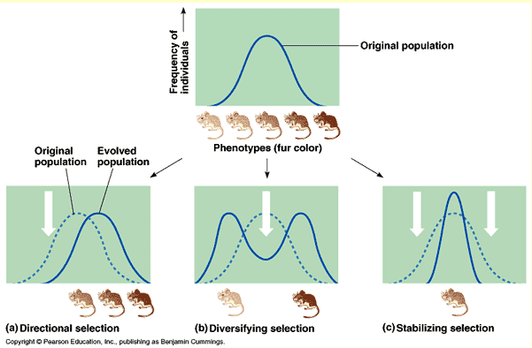
DO NOW: Draw and Label Graphs in Notebooks (3 min)

Slide 35
Types of Natural Selection
Type | Definition | Result
Directional Selection
Disruptive Selection
Stabilizing Selection
Notes:
Make sure students understand that sometimes natural selection, particularly stabilizing selection, maintains status quo rather than causing major trait changes in a population.

Slide 36
Types of Natural Selection
Type | Definition | Result
Directional Selection | A process of natural selection in which a single phenotype at one extreme of the phenotypic range is favored | The population's trait distribution shifts toward an extreme.
Disruptive Selection
Stabilizing Selection
Notes:
Make sure students understand that sometimes natural selection, particularly stabilizing selection, maintains status quo rather than causing major trait changes in a population.

Slide 37
Types of Natural Selection
Type | Definition | Result
Directional Selection | A process of natural selection in which a single phenotype at one extreme of the phenotypic range is favored | The population's trait distribution shifts toward an extreme.
Disruptive Selection | A process of natural selection that favors individuals at both extremes of a phenotypic range | Can cause such differences among a species that the variation leads to new species (SPECIATION)
Stabilizing Selection
Notes:
Make sure students understand that sometimes natural selection, particularly stabilizing selection, maintains status quo rather than causing major trait changes in a population.

Slide 38
Types of Natural Selection
Type | Definition | Result
Directional Selection | A process of natural selection in which a single phenotype at one extreme of the phenotypic range is favored | The population's trait distribution shifts toward an extreme.
Disruptive Selection | A process of natural selection that favors individuals at both extremes of a phenotypic range | Can cause such differences among a species that the variation leads to new species (SPECIATION)
Stabilizing Selection | A process of natural selection that tends to favor genotypic combinations that produce an intermediate phenotype | It reduces phenotypic variation. Natural selection tends to remove the more severe phenotypes. MAINTAINS STATUS QUO
Notes:
Make sure students understand that sometimes natural selection, particularly stabilizing selection, maintains status quo rather than causing major trait changes in a population.

Slide 39
Mechanisms of Evolution Models
Look back at your graphic organizer. We will be exploring the following processes and their influence on population change (evolution):
Natural Selection
Mutations
Gene flow
Genetic drift
Artificial selection
Non-random mating
There are too many limits to this model to explore recombination and reproductive isolation. Those will be explained after the models.

Slide 40
Mechanisms of Evolution Models
The circles help distinguish the original population makeup from what it might look like after the change and its makeup many, many generations later.
The dots represent individual organisms within the population.
Original Population

Slide 41
Mechanisms of Evolution Models
Instead of thinking about the dots as representing a single individual, think about them representing a percentages of individuals.
For example, in the population shown below, about half of the individuals are red, a quarter are blue, and a quarter are green. That means that if 1,000 individuals made up that population, about 500 would be red, about 250 blue, and 250 green.
Original Population
When predicting outcomes, use estimations. Don’t get stumped thinking about exactly how many dots are in a population!!

Slide 42
Mechanisms of Evolution: Natural Selection
Original Population
Notes:
We will start with natural selection. Students should already be familiar with natural selection so this one should help them understand how the model works without having to understand new concepts.
Each group should set up the Original Population as they see it here.
Have them read the scenario and predict and set up what the population would look like after the chemical spill using their dots.

Slide 43
Mechanisms of Evolution: Natural Selection
After Chemical Spill
Notes:
Give students time to predict and show how the population would look after many generations.

Slide 44
Mechanisms of Evolution: Natural Selection
Many Generations Later
Notes:
Make sure students compare the original population to the population many generations later. This will help them see how the population changed as a result of natural selection.

Slide 45
Mechanism of Evolution: Mutations
Original Population

Slide 46
Mechanism of Evolution: Mutations
After Mutation

Slide 47
Mechanism of Evolution: Mutations
Many Generations Later
Notes:
Make sure students compare the original population to the population many generations later. This will help them see how the population changed as a result of the mutation.

Slide 48
Mechanisms of Evolution: Mutations
Real-World Examples:
http://evolution.berkeley.edu/evosite/evo101/IIIC2aCasestudy.shtml

Slide 49
Mechanism of Evolution: Gene Flow
Neighboring
Population
Original Population

Slide 50
Mechanism of Evolution: Gene Flow
After Migration

Slide 51
Mechanism of Evolution: Gene Flow
Many Generations Later
Notes:
Make sure students compare the original population to the population many generations later. This will help them see how the population changed as a result of migration/gene flow.

Slide 52
Mechanisms of Evolution: Gene Flow
Real-World Examples:
http://evolution.berkeley.edu/evosite/evo101/IIIC4aGeneflowdetails.shtml

Slide 53
Mechanisms of Evolution: Genetic Drift
Original Population

Slide 54
Mechanisms of Evolution: Genetic Drift
After Lightning

Slide 55
Mechanisms of Evolution: Genetic Drift
Many Generations Later
Notes:
Make sure students compare the original population of the population many generations later. This will help them see how the population changed as a result of genetic drift.
Discuss that genetic drift tends to happen in populations that are small, where random events could have significant impacts on the genetic makeup of the population. At this point, make sure you explain the bottleneck and founder’s effect.
http://www.bio.georgiasouthern.edu/bio-home/harvey/lect/lectures.html?flnm=nsln&ttl=Population%20change%20and%20natural%20selection&ccode=el&mda=scrn

Slide 56
Mechanisms of Evolution: Genetic Drift
Real-World Examples:
http://www.bio.georgiasouthern.edu/bio-home/harvey/lect/lectures.html?flnm=nsln&ttl=Population%20change%20and%20natural%20selection&ccode=el&mda=scrn
http://highered.mcgraw-hill.com/sites/dl/free/0072835125/126997/animation45.html

Slide 57
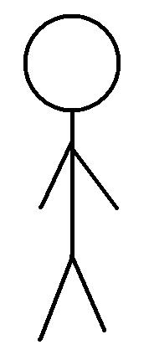
Mechanisms of Evolution: Artificial Selection
Original Population

Slide 58
Mechanisms of Evolution: Artificial Selection
Many Generations Later

Slide 59
Mechanisms of Evolution: Artificial Selection
Real-World Examples:
http://learn.genetics.utah.edu/content/variation/artificial/

Slide 60
Mechanisms of Evolution: Non-Random Mating
Original Population
Blue = BB or Bb
Red = bb
x
Notes:
Students may need to think about Punnett squares probability of offspring. It maybe helpful to do a cross between two heterozygotes and also two red individuals. This will show students that not only are red individuals all red offspring but blue individuals are also producing red offspring as well. Because of this and non-random mating, the frequency of red alleles will increase many generations later.

Slide 61
Mechanisms of Evolution: Non-Random Mating
Many Generations Later

Slide 62
Mechanisms of Evolution: Non-Random Mating
Real-World Examples:
http://www.bio.georgiasouthern.edu/bio-home/harvey/lect/lectures.html?flnm=nsln&ttl=Population%20change%20and%20natural%20selection&ccode=el&mda=scrn

Slide 63
Limits
The models make it seem that these processes happen separately and exclusively from each other. The fact is that numerous mechanisms are simultaneously changing and molding the genetic makeup of a population.
Population numbers in a real ecosystem are much larger than what we can represent with dots on our desk.
The genetic makeup and allele frequencies in a population are much more complicated than blue, green, and red colors.
These models are to help you understand the basic definitions and processes of evolution, but remember, genetic change on a population scale is MUCH, MUCH, MUCH more complex than these models can show.

Slide 64
Mechanisms of Evolution: Recombination & Genetic Shuffling
As we learned in the genetics unit, recombination leads to genetic material being shuffled.
This shuffling, along with sexual reproduction, leads to variation within populations. This variation leads to selection, which ultimately leads to evolution.
http://evolution.berkeley.edu/evolibrary/article/evo_22

Slide 65
Mechanisms of Evolution: Reproductive Isolation
A new species may form when one population of a species becomes reproductively isolated from another population of the same species.
Over time, evolutionary mechanisms occur that alter the gene pool of the isolated population so that it is no longer reproductively compatible with the original population.
Notes:
Resource with examples: http://evolution.berkeley.edu/evolibrary/article/evo_40

Slide 66
What is a Species?
A group of individuals that actually or potentially interbreed in nature. A species is the biggest gene pool possible under natural conditions.
Scientists group organisms according to their similarities.
The most similar organisms belong to a species.
Members of the same species can mate and produce fertile offspring.
Ex: Humans belong to the species Homo sapiens.

Slide 67
How Do New Species Evolve?
Speciation is a lineage-splitting event that produces two or more separate species.
Since being a member of one species is defined by the ability to successfully reproduce, speciation (the formation of a different species) must involve an inability to successfully reproduce.

Slide 68
Reproductive Isolation
Two way reproductive isolation occur:
Prezygotic mechanisms
Postzygotic mechanisms

Slide 69
Prezygotic Mechanisms
Temporal Isolation: Species reproduce in different seasons or at different times of the day.
Geographical Isolation: Physical barriers (e.g., rivers, oceans, mountains) prevent the mixing of populations.
Behavioral Isolation: Species differ in their mating rituals (e.g., differing bird songs, mating colors, dances, pheromones).
Mechanical Isolation: Body structure prevents mating.

Slide 70
Postzygotic Mechanisms
Hybrid inviability: Embryological Arrest: Hybrid embryos often do not develop properly; no viable offspring is created.
Hybrid Sterility: Infertility: Hybrid offspring might grow to viable adults, but these are infertile and cannot produce further offspring
This shuffling, along with sexual reproduction, leads to variation within populations. This variation leads to selection, which ultimately leads to evolution.
(Donkey + Horse = Mule; Mule is sterile.)

Slide 71
Cladogenesis
Cladogenesis is the splitting of one species into two.
How does this happen?
Geographical (physical) isolation, which leads to reproductive isolation. This is also known as allopatric speciation.

Slide 72
How Evolution Occurs
There are two scientific theories regarding how evolution occurs.
Punctuated Equilibrium: This theory proposes that throughout geological time, biological species go through long periods of little change and then have brief periods of rapid change.
Gradualism: This theory proposes that throughout geological time, biological species gradually undergo changes that leads to speciation.
Notes:
This will be explored more in the next lesson.

