Slide 1
Political Cartoon Assignment

Slide 2
Instructions:
Using the 9 square method, analyzing the following 6 political cartoons
Click on the following link to access a blank 9 Square google doc.
https://docs.google.com/document/d/1JpZAudtJpP9RP9VNrt1wscQxu_CpgcjOnMQ68jNUUiQ/edit?usp=sharing
You will need to make a copy of this document, and use that to analyze the following cartoons.
When you are finished, submit it to the assignment on Canvas labeled “Political Cartoon Assignment”

Slide 3
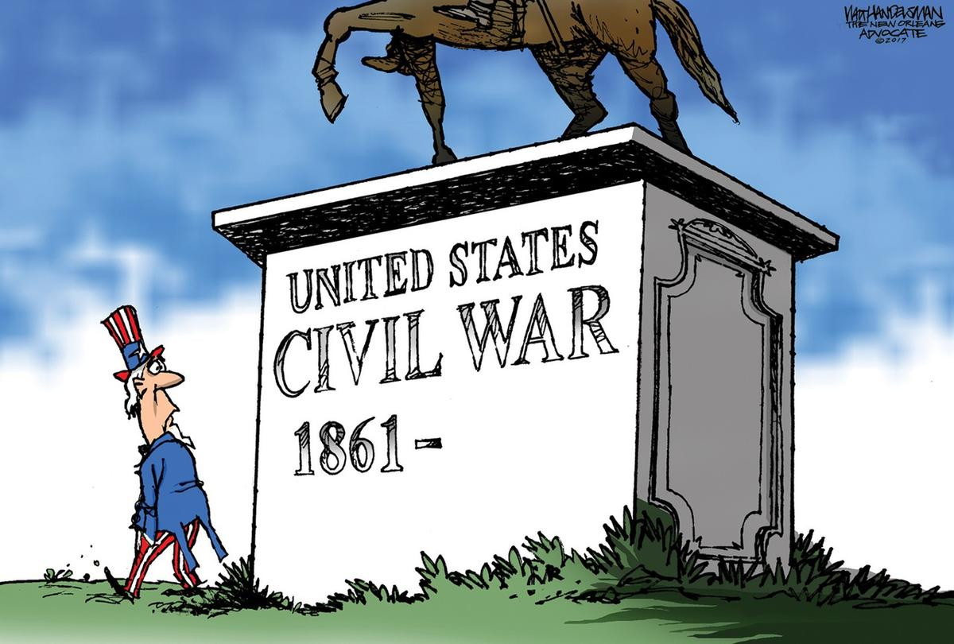
#1

Slide 4
#2

Slide 5
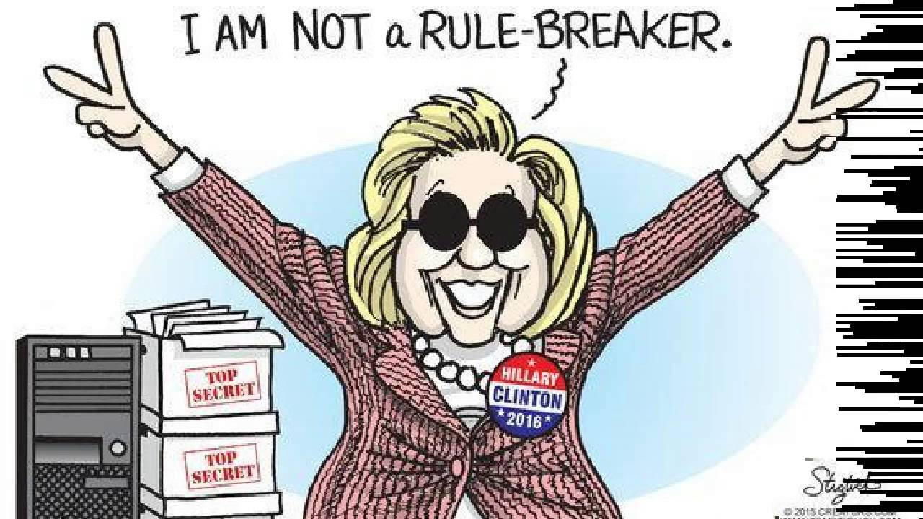
#3

Slide 6
#4

Slide 7
#5

Slide 8
#6

