Slide 1
Steps to analyzing political cartoons

Slide 2
9 Squares
1 | 2 | 3
4 | 5 | 6
For this class, we will be using the 9 Square method of analyzing political cartoons.
In squares 1-6, you will write down what you SEE.
What do you see?
Details, signs, people, etc.

Slide 3
9 Squares
7
In Square 7, you will need to write down what you think it means.
What does it mean?

Slide 4
9 Squares
 | 8
In Square 8, you will need to write down why you think the cartoon is important.
Why does it matter?

Slide 5
9 Squares
 |  | 9
In Square 9, you will need to write down who you think the author made the political cartoon for.
Who is the targeted audience?

Slide 6
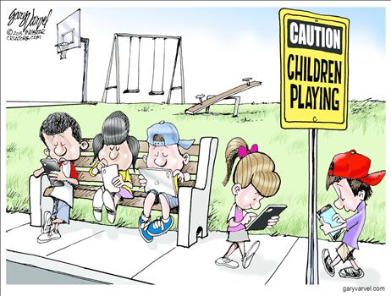
Example #1
Kids | Sign saying “caution children playing” | Playground
Phones | Boys and girls | Park bench
Kids are too attached to electronic devices to be bothered to play outside like they used to | Shows that things will never be like the “old days”. Criticizing the younger generation | People of the older generation

