Slide 1
THINK LIKE
A HISTORIAN
Notes:
Discussion Tip: Ask students what it means to “think like a historian.” How is this different from thinking like a scientist or mathematician?

Slide 2
Warm-up: Why is the study of history important?

Slide 3
Essential Question: What are the tools historians use to think about the past?

Slide 4
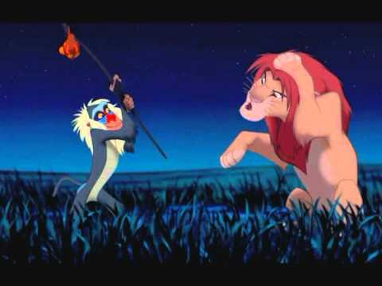
WHY STUDY HISTORY?

Slide 5
Historical Questions
Who are we and where do we come from?
Why do people believe the things they do?
What causes conflict, and how can it be prevented—or should it be?
With our….
“THINK LIKE A HISTORIAN” Skills
(TLAH)
And how do we answer any of these questions?
What accounts for poverty and inequality, prejudice and discrimination, or the success and failure of nations?
Why have people organized their societies, economies, and environments in different ways, and why do they still?
What influences the choices people make?

Slide 6
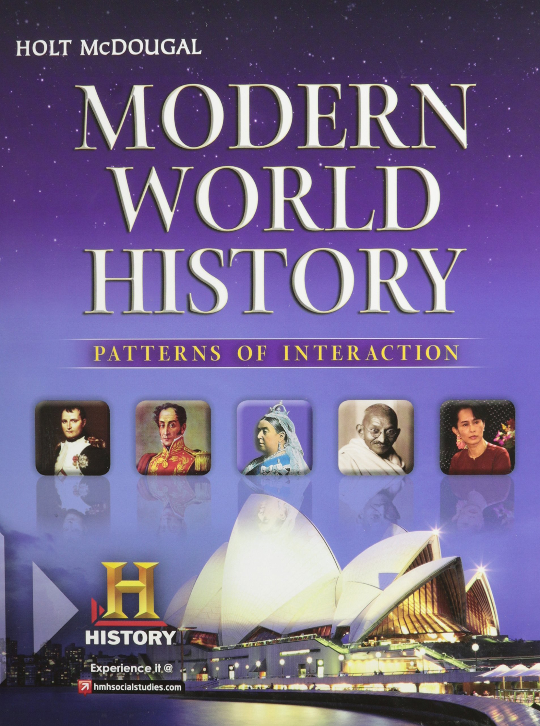
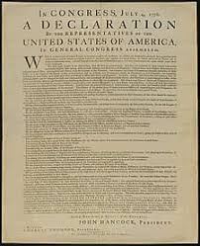
Historians…. USE EVIDENCE
Evidence is proof used to support an argument or point-of-view.
Secondary Source = created after the time period of study (ex. Textbook)
Primary Source = from the time period of study

Slide 7
Historians…. USE EVIDENCE
Normative texts | legal texts or codes of law
Journals | personal reflections, diaries
Visuals | maps, photos, art, political cartoons
Public Records | census, birth/death records, city directories
Literature | poems, books
Newspaper | local, state, national
Artifacts | objects made by humans
Oral History | interviews or stories passed down

Slide 8
Historians…. USE EVIDENCE
What can that evidence be used for? What can it tell us?
What are some limitations of the source?

Slide 9
TLAH and YOU
Skills Practice
Choose one “life event.”
What is an example primary source that could tell us about this event? Describe.
What type of primary source is it?
What are its limitations?
Your example here.

Slide 10
Historians…. SEE HISTORICAL PERSPECTIVES
A historical perspective is one that considers the context or background information of people and events of the past in their judgement.
Important questions:
How can we understand the differences between our society and the past?
Why do people think and act the way they do?
Why did this event happen the way it did?

Slide 11
TLAH and YOU
Skills Practice
Use the same “life event” and give one piece of background information that helps us to understand the event.
Example: Where did it happen? When did it happen? What was going on in the world at the time?
Your example here.

Slide 12
Historians…. IDENTIFY CAUSE AND CONSEQUENCES
A cause is the origin of something or reason for action. A consequence is the outcome, either positive or negative.
Important questions:
What is the cause of an event or decision?
What is the consequence of an event or decision?

Slide 13
TLAH and YOU
Skills Practice
What caused this event?
What was a consequence of this event?
Your example here.

Slide 14
Historians…. IDENTIFY CHANGE AND CONTINUTITY
A change is a new development or shift. Continuity is when conditions stay the same (between time period or geographic locations).
Important questions:
What changes and why?
What stays the same and why?

Slide 15
TLAH and YOU
Skills Practice
What changed or what stayed the same in this event?
Your example here.

Slide 16
Historians…. ADDRESS ETHICAL ISSUES
Ethics are morals or questions of right and wrong. Ethical issues are ones that have an ethical or a “right choice” and an unethical or “wrong choice”.
Important questions:
How do we deal with the decisions, good AND bad, made my historical actors?
How do these decisions affect us today?

Slide 17
TLAH and YOU
Skills Practice
Did this “life event” involve an ethical issue?
***Not everything is an ethical issue. It is important to know how to identify an ethical issue, as well as the moral choices.
Your example here.

Slide 18
Historians…. IDENTIFY SIGNIFICANCE
Significance is the importance of something. A historical event, person, or idea can be significant because of its impact on society.
Important questions:
Why is this significant or important?
Who determines significance?

Slide 19
TLAH and YOU
Skills Practice
What was the importance or impact of this event?
Your example here.

