Slide 1
Charts, Maps, and Graphs

Slide 2
First thing:
The first thing you need to do whenever you see a chart, map, or graph is to READ THE TITLE
This will tell you what kind of information you are looking at
In most cases, you will be able to eliminate at least one answer choice
You will need to read all of the information on the graph
This includes the Key, the data on the X and Y axis, map legend, etc.

Slide 3
Maps
There are many different types of maps that you could see on tests.
Political Maps – show boundaries made by man
Countries, States, etc
Physical Maps – Show land elevation and physical characteristics
Qualitative – Shows nominal data, distribution, no quantities
Quantative – Shows numerical data, variation from place-to-place, Generalized numbers

Slide 5
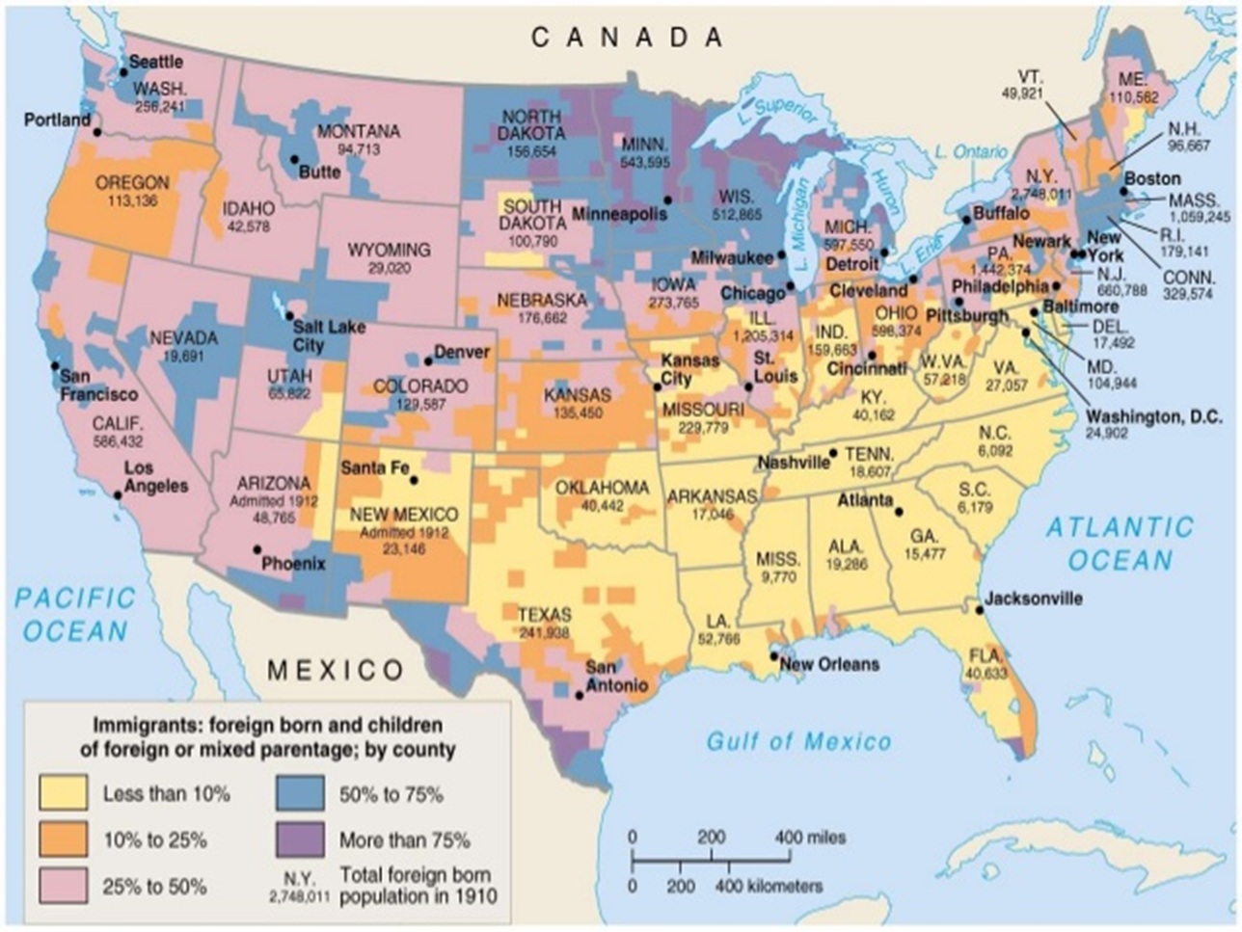
Maps
Quantative

Slide 6
Maps

Slide 7
Maps
Based off this map, what do you think it is about?
How many different countries took part?
When did the D-Day Inavsion take place?

Slide 8
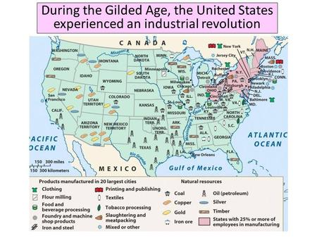
Maps
Based off this map, what do you think it is about?
What type of resource is in Texas?
Where are most of the Natural Resources found?
Where are most of the products manufactured?

Slide 9
Charts and Graphs

Slide 10
Bar Graphs
Bar graphs - presents categorical data with rectangular bars with heights or lengths proportional to the values that they represent.

Slide 11
Line Graph
Line graphs - measurement points are ordered (typically by their x-axis value) and joined with straight line segments. A line graph is often used to visualize a trend in data over intervals of time, often drawn chronologically.

Slide 12
Histogram
Histogram - an accurate representation of the distribution of numerical data. It is an estimate of the probability distribution of a continuous variable.

Slide 13
Pie Chart
Pie Chart - circular statistical graphic which is divided into slices to illustrate numerical proportion. In a pie chart, the arc length of each slice, is proportional to the quantity it represents.

Slide 14
Flow Chart
Flow Chart - a type of diagram that represents an algorithm, workflow or process. The flowchart shows the steps as boxes of various kinds, and their order by connecting the boxes with arrows.

Slide 15
Charts & Graphs
What type of chart or graph is this?
How can you tell?
What is it about?

Slide 16
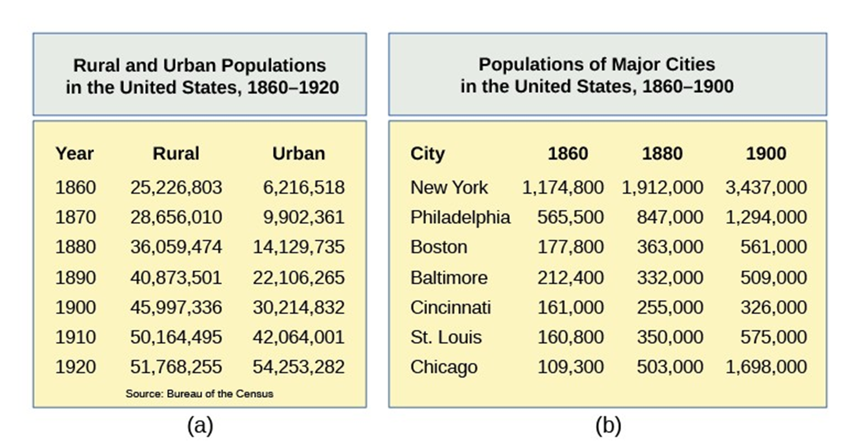
Charts and Graphs
What is these charts about?
What date range do the charts represent?
On Chart A (top), How would I find the Urban population in 1880?
On the bottom map, what is the difference in population in New York between 1860 and 1900?

