Slide 1
Mrs. Baxter
Science Class

Slide 2
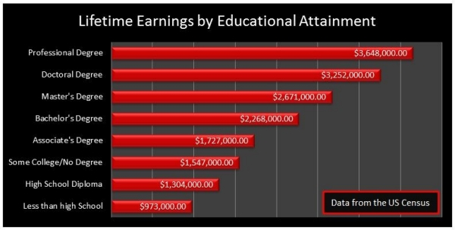
Why do I have to do this? Why do I need to learn this?

Slide 3
Entering Class
Never enter when the teacher is not in the room
Enter through the door at the end of the hallway
Get all materials ready
Start your warm up
Talking STOPS when the tardy bell rings

Slide 4
During Class
Follow directions the FIRST time they are given
Keep hands, feet, and objects in your space
Ask permission to leave your seat
Bring all materials to class - science notebook and pencil
Stay on task

Slide 5
Leaving Class
Wait until I dismiss class, do not try to run out when the bell rings
You may exit either door
Make sure your workstation or table is clean
Make sure you have all of your belongings

Slide 6
Devices
Watch red/green devices sign at the front of the room
Red - no devices all period
Green - devices are placed in the middle of the table, screen side down
On device days - only out when you are told you can use it, and used ONLY in the manner instructed (no social media, games, etc)

Slide 7
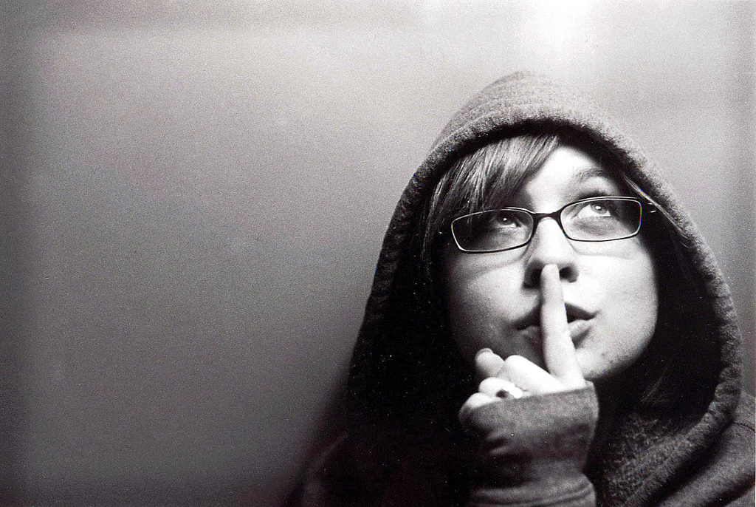
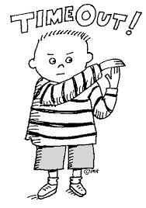
Silent Signal
When you see the “timeout” signal you...
Stop talking
Make the “time out” signal yourself so that others may also see it

Slide 8
Restroom Break
Only 3 passes per six weeks
On YOUR time, not during instruction or labs
Not during the first or last 15 minutes of class

Slide 9
Group Work
The 2 C’s - Communication and Cooperation
Q-TIP
Stay with your group
One person talks at a time
Talk only about your work
Everyone participates
Do not disturb other groups
Notes:
2C’s = Positive communication leads to cooperation
Q-TIP = quit taking it personal

Slide 10
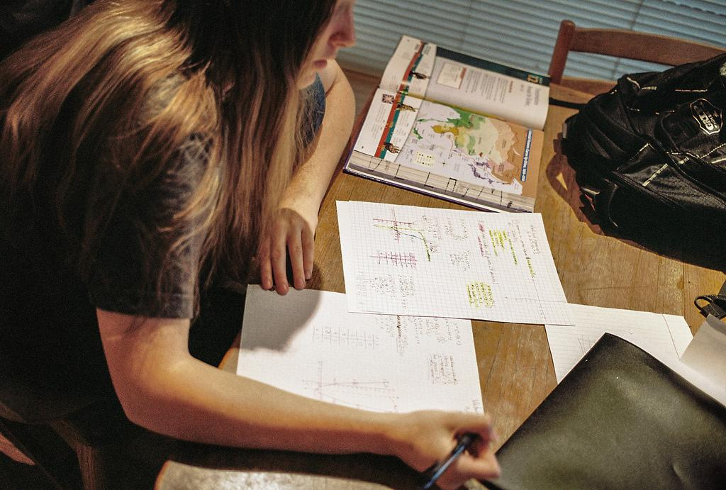
Classwork and Homework
Classwork is due before you leave class on the same day, unless you are told to take it home.
Turn in assignments on or before the due date, late work will be penalized
Turn in work to me...the teacher.

Slide 11
Absent/Tardy
If you are tardy, come in quietly
Getting make-up work is YOUR responsibility
Assignments will be posted on the make-up work calendar and necessary papers will be available in the folders below it
You have one day for each day you were absent to turn in your assignments

Slide 12
Consequences
1-2 Points = Warning
3 Points = Parent Contact
4 Points = Detention
5 Points = Office Referral
Major infractions will result in an office referral
Points reset at the end of each week

Slide 13
Grades
Homework and Classwork = 50%
Test/Project = 50%
Any test grade below 70 can be retaken for a maximum of a 70
Retests should be scheduled before or after school

